Slide 1
WELCOME GRADE 8’s
2021

Slide 2
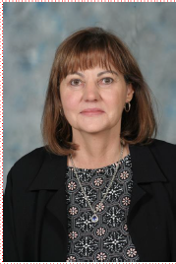
Principal Mrs. ASH Peens
Speaking…

Slide 3
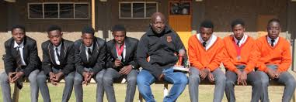
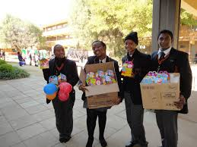
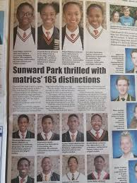
Sunward Legacy

Slide 4
Education and e-Learning
Discipline policy and its effectiveness on academics.
Top Ten
in Province
Covid-19 times.
Quality education
ICT Team
Consistent efforts to maintain our results

Slide 5
Back to school amid Covid19
Safe and clean – Covid compliant environment
15th of February 2021

Slide 6
School uniform
NB:
Please dress aptly in full school uniform and avoid any compromising situations as we would like to start off your high school journey on a positive and memorable note.

Slide 7
THANK YOU!

